Slide 1





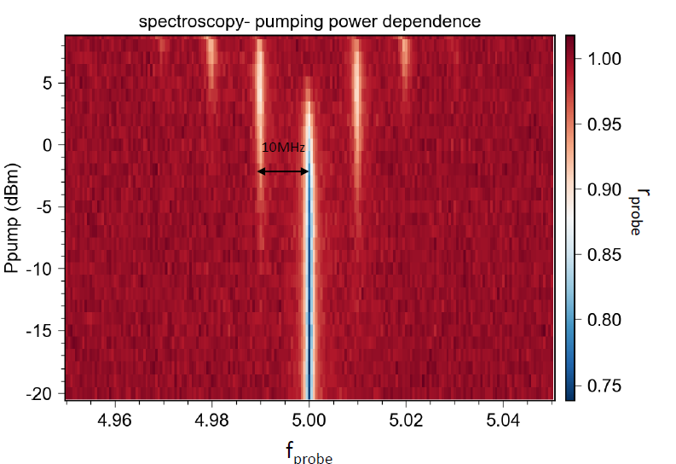
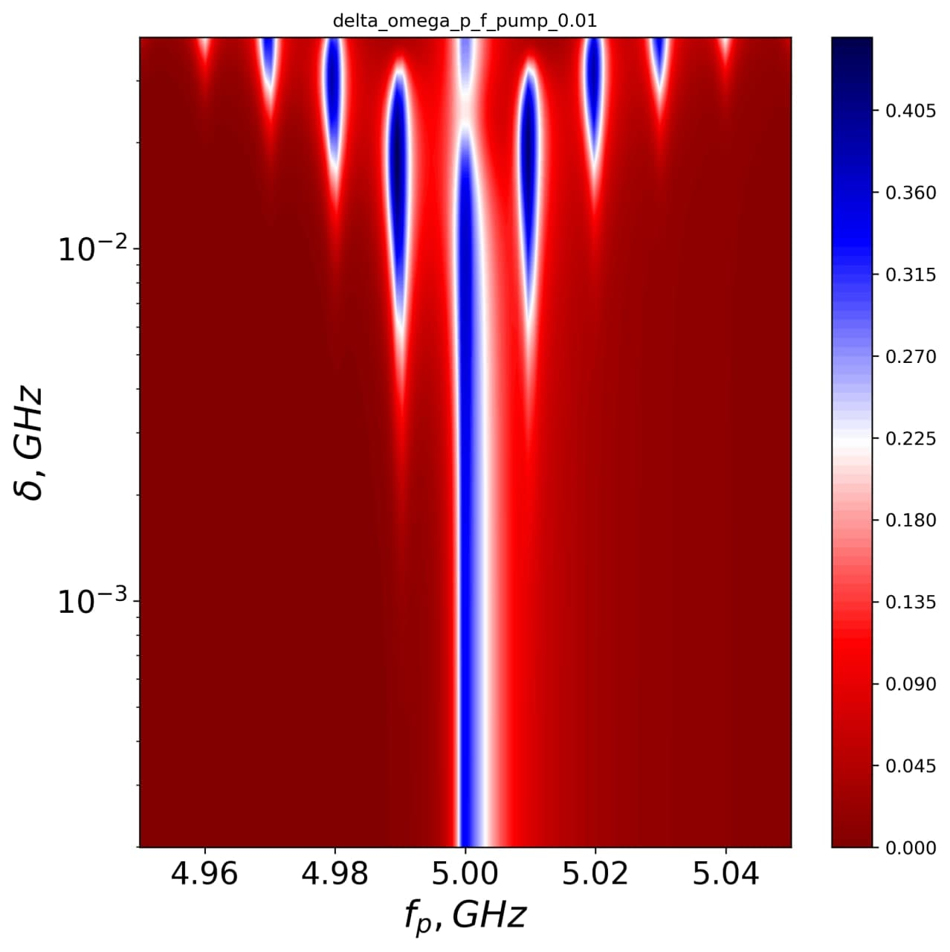
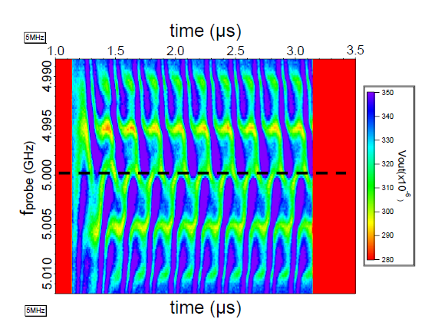
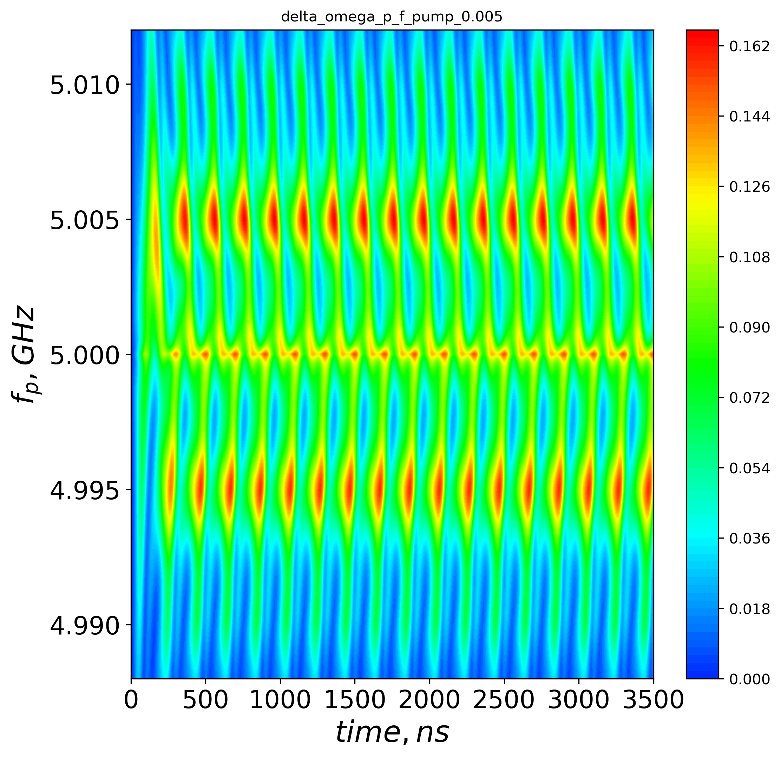
Coherent dynamics of a photon-dressed qubit
Maksym Liul¹, Chin-Yeh Chen⁵, Chih-Hsun Chien⁵,
Sergey N. Shevchenko^{1,2}, Franco Nori ^{3,4}, IoChun Hoi^{5,6}
¹ B. Verkin Institute for Low Temperature Physics and Engineering, Kharkiv, Ukraine
² V. N. Karazin Kharkiv National University, Ukraine
³ Theoretical Quantum Physics Laboratory, RIKEN, Japan
⁴ The University of Michigan, Ann Arbor, USA
⁵ Department of Physics, National Tsing Hua University, Hsinchu, Taiwan
⁶ Center for Quantum Technology, National Tsing Hua University, Hsinchu, Taiwan
Experiment
Theory
Experiment
Theory
Stationary state – interferometry – characterization
Time-dependent case

Slide 2
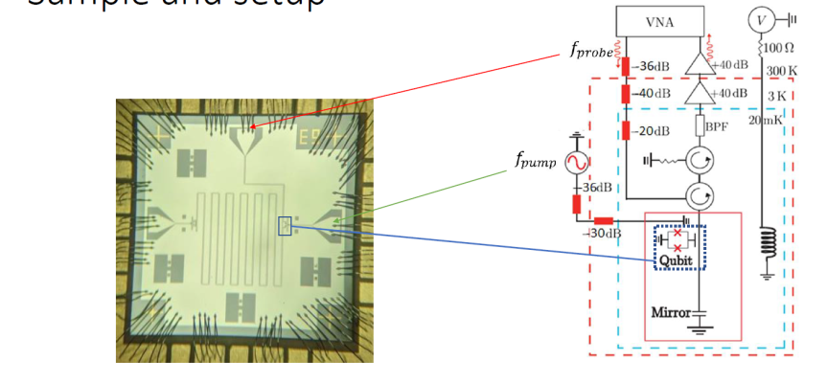
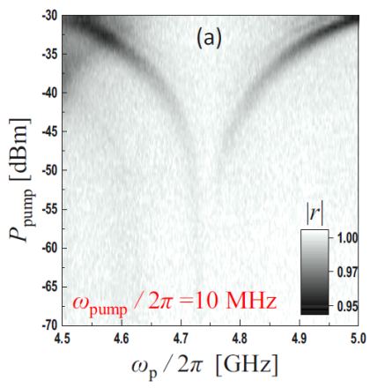

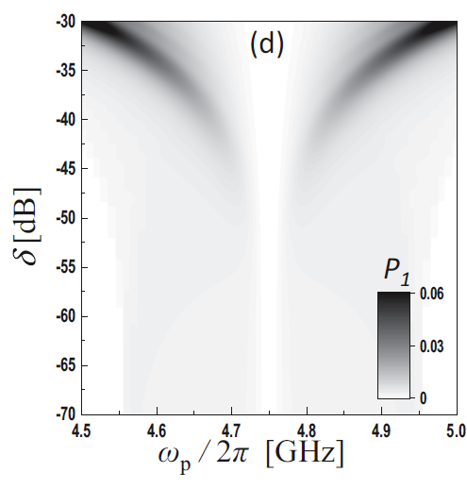
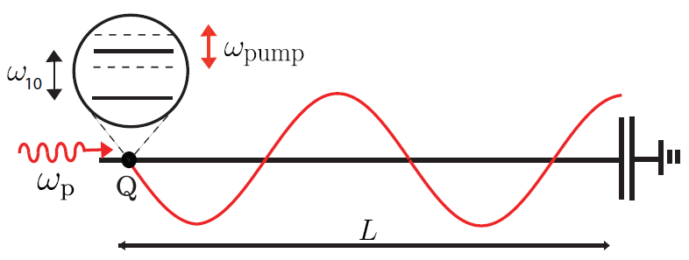




Transmon qubit in front of a mirror: Stationary case
r = reflection coefficient
Experiment
[P. Y. Wen et al., Phys. Rev. B, 2020]
System Hamiltonian
P₁ = probability that the
system is in the charge state
(and it is proportional to
the reflection coefficient).
Probe signal
Energy levels modulation
Theory
2

Slide 3
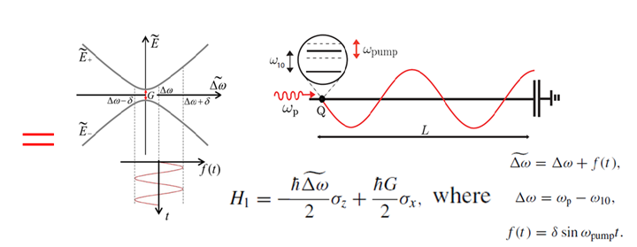
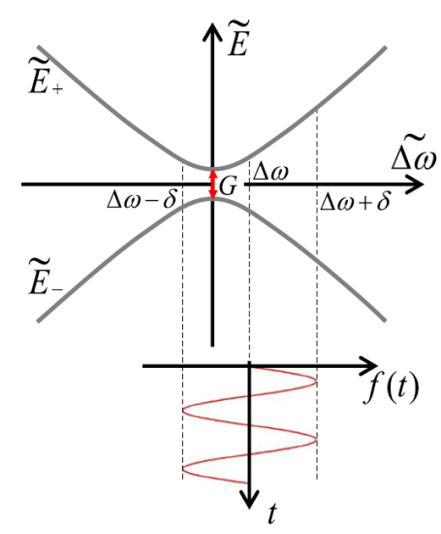

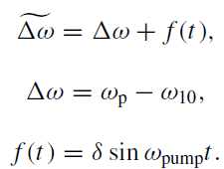
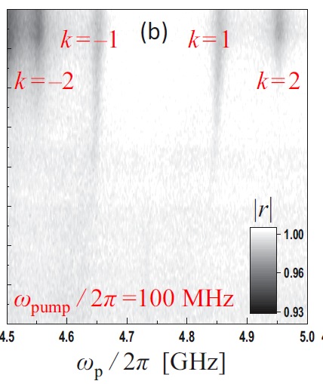
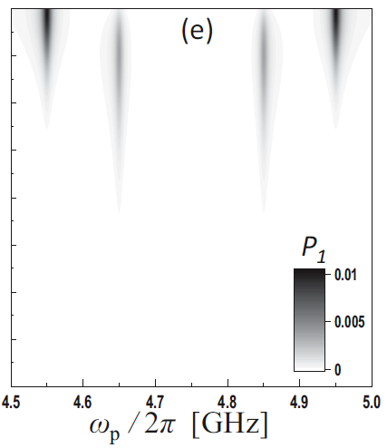

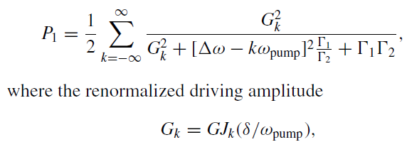
Theoretical description: Stationary case
Effective two-level system
Hamiltonian
Unitary transformation
Energy levels
modulation
Probe signal
By solving the stationary Bloch equation with H₁ for the probability P₁ that the system is in the charge state we have:
Experiment
Theory
3

Slide 4
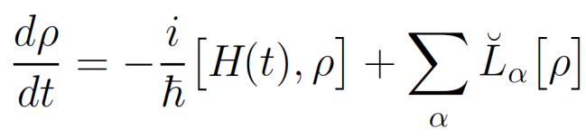
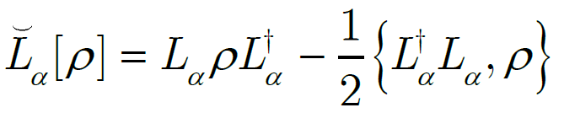

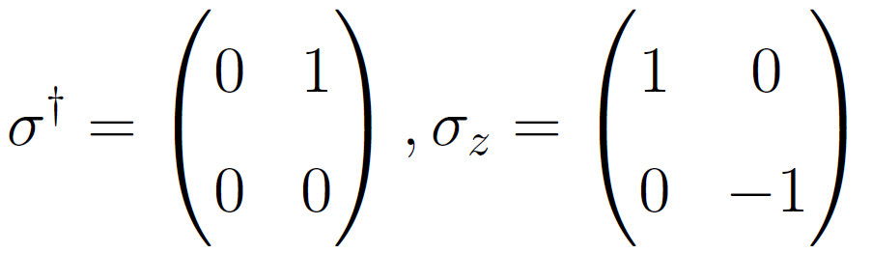
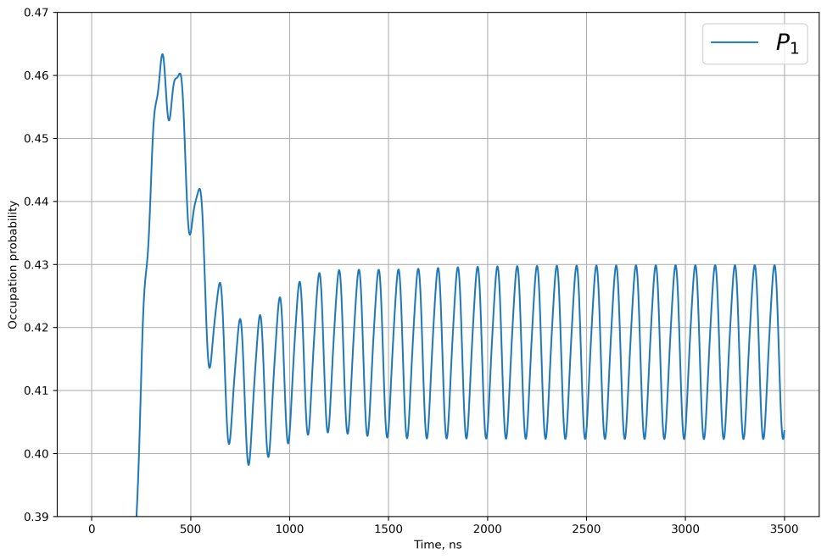
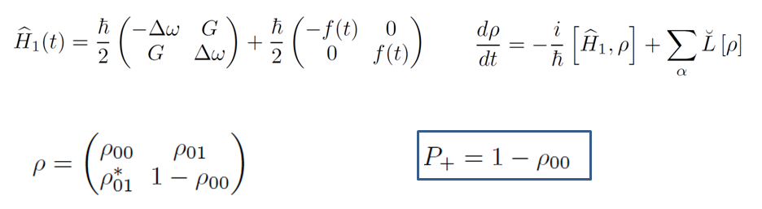

Theoretical description: Time-dependent case
The dynamics of open quantum systems is described by the Lindblad equation.
The interaction with the environment is
described by the Lindblad superoperators
The interaction with the environment causes energy relaxation and dephasing.
Each relaxation channel is described
by the Lindblad operator L_{α}.
In case of a qubit there are two relaxation channels.
Present case
Stationary regime
We average over time >> time of stationary regime
4

Slide 5
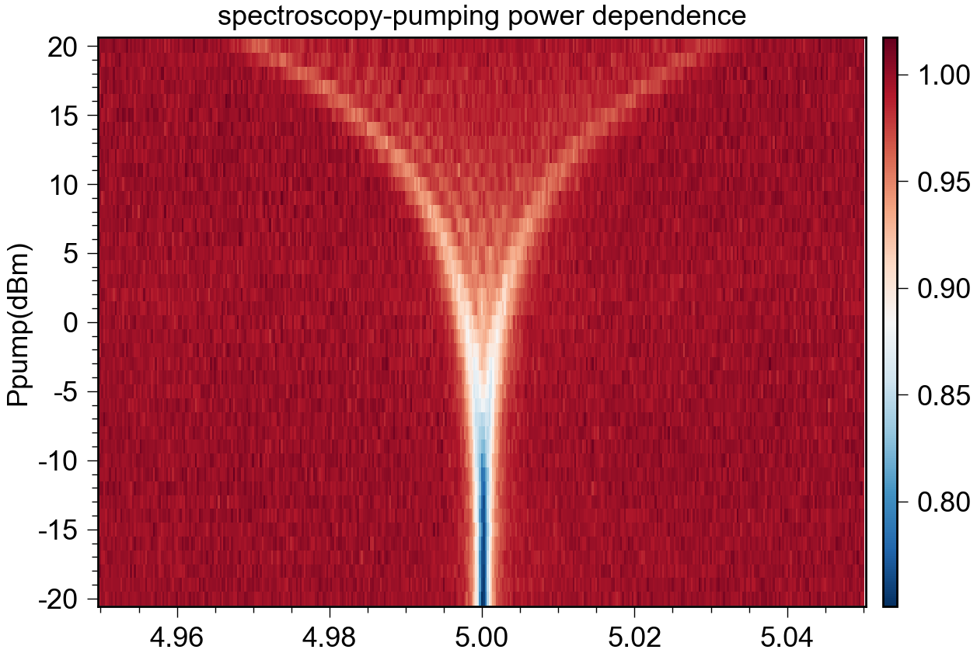
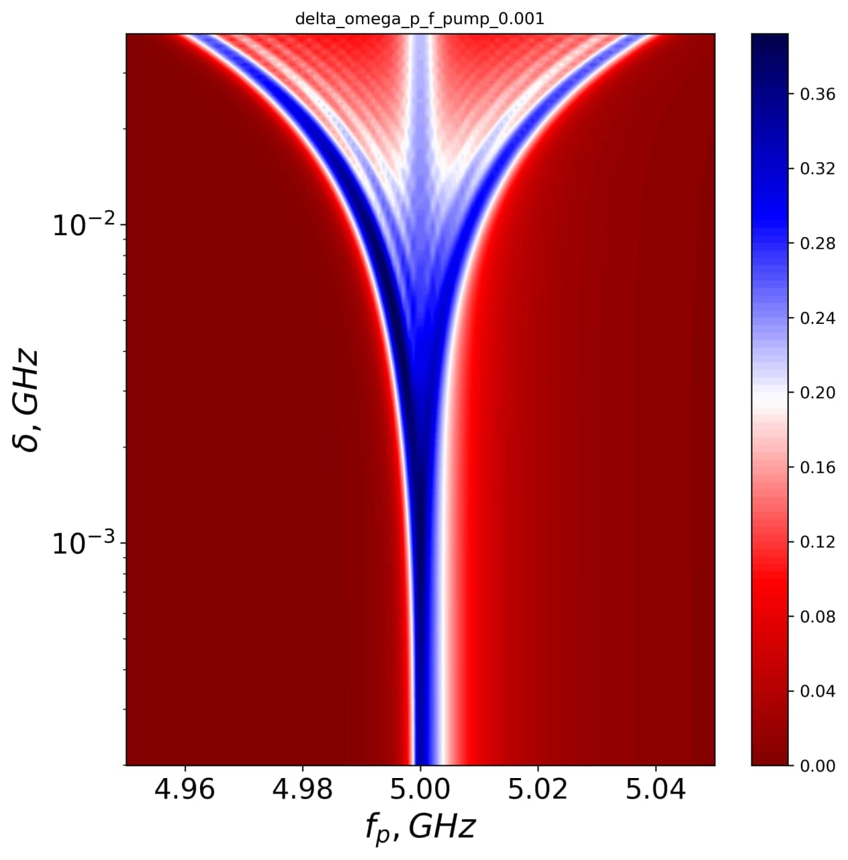

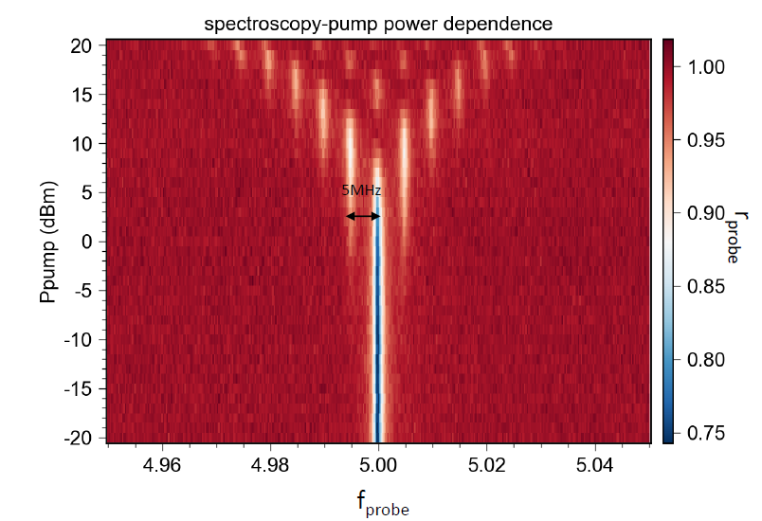
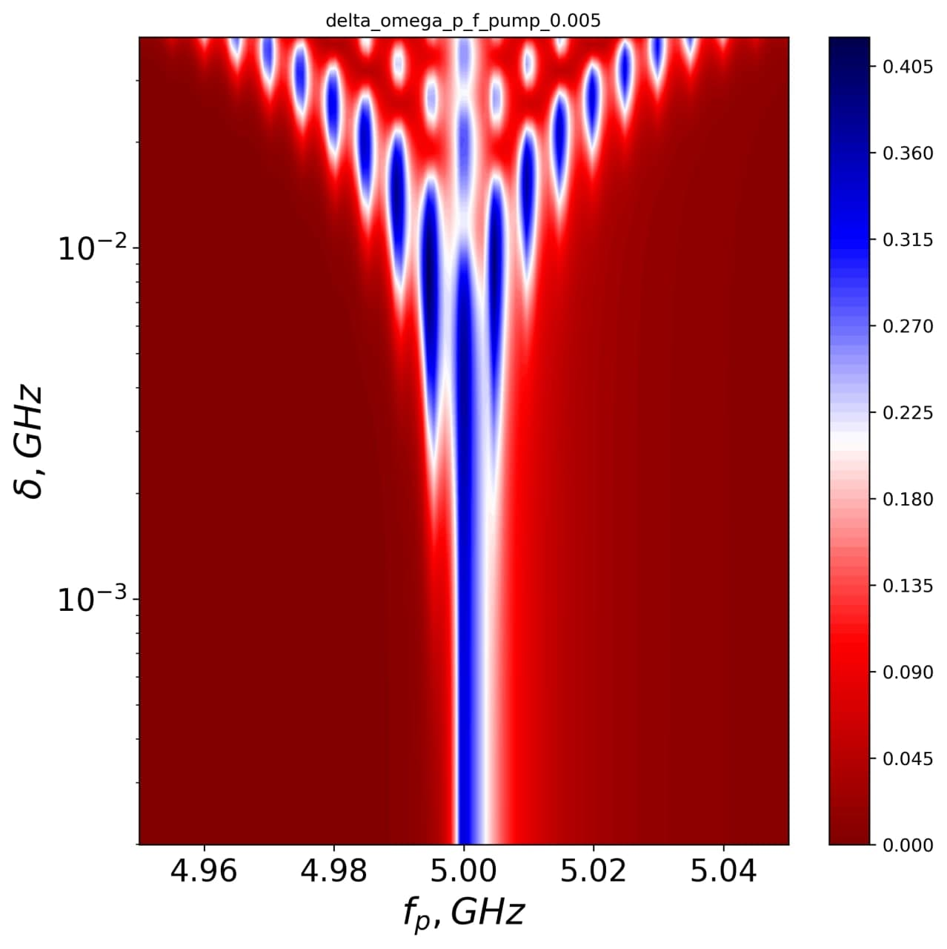




Interferograms: for system’s characterization
Experiment
Decoherence estimation
Theory
P₁
f_{pump} = 1 MHz
Power calibration
P₁
f_{pump} = 5 MHz
Position of resonance: for multi-photon spectroscopy
P₁
f_{pump} = 10 MHz
5

Slide 6
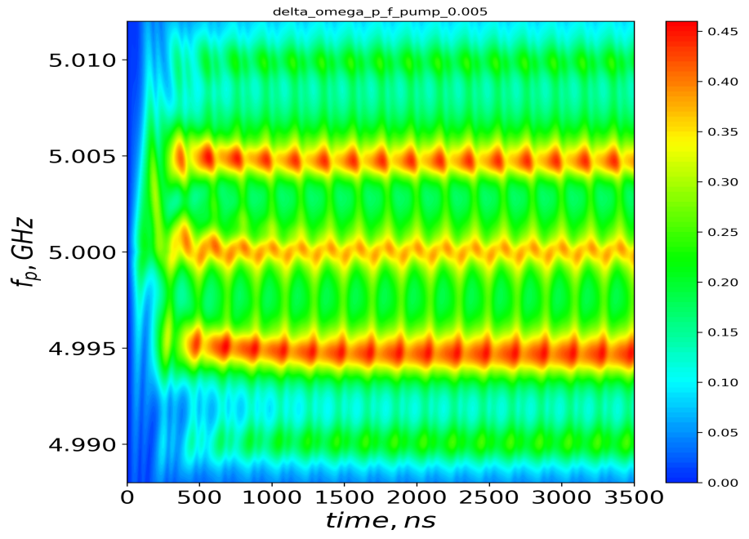

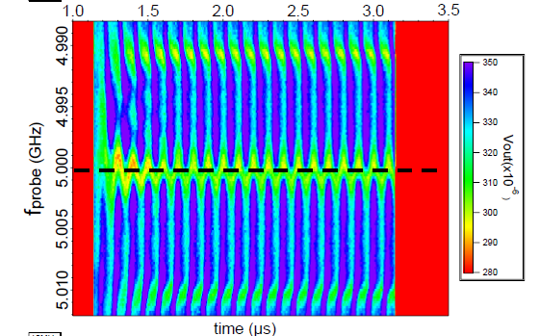
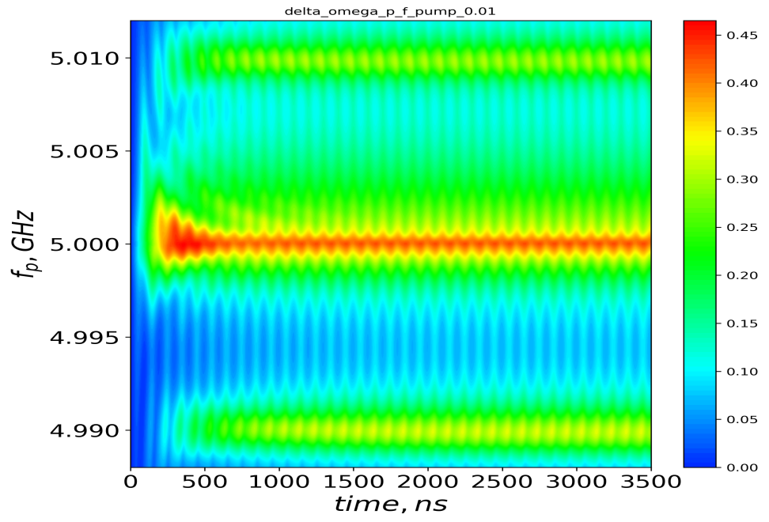

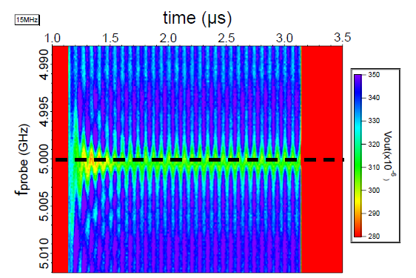
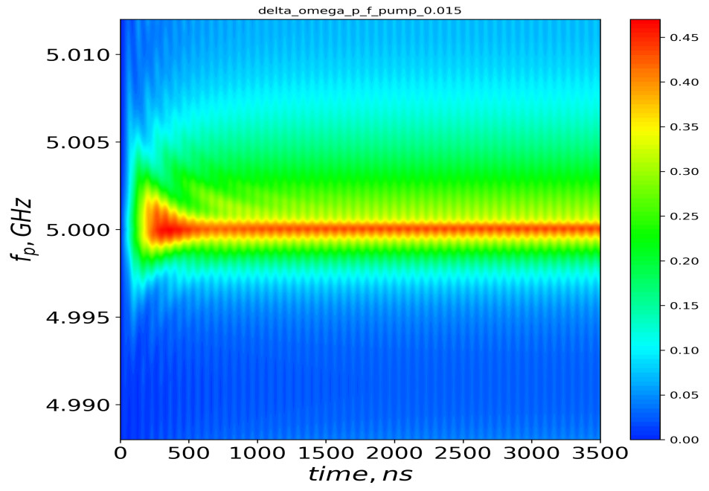
Time-dependent case: Quantum dynamics
Experiment
Theory
P₁
f_{pump} = 5 MHz
P₁
f_{pump} = 10 MHz
P₁
f_{pump} = 15 MHz
6

Slide 7
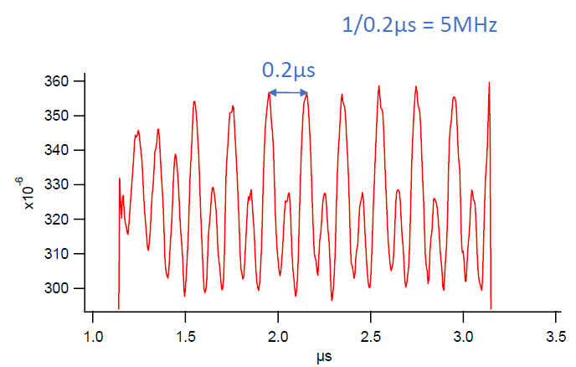
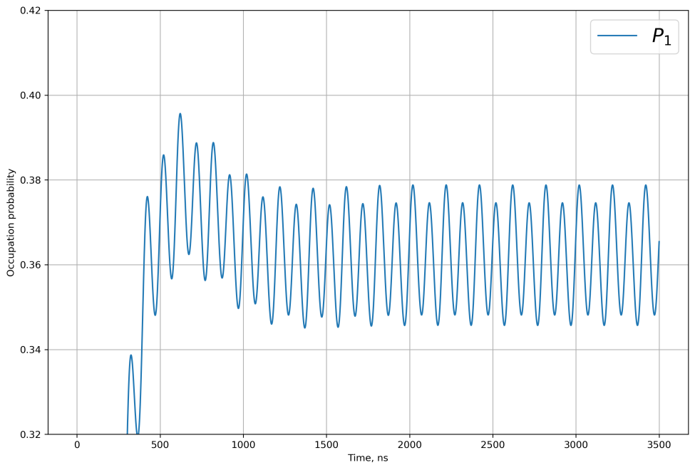
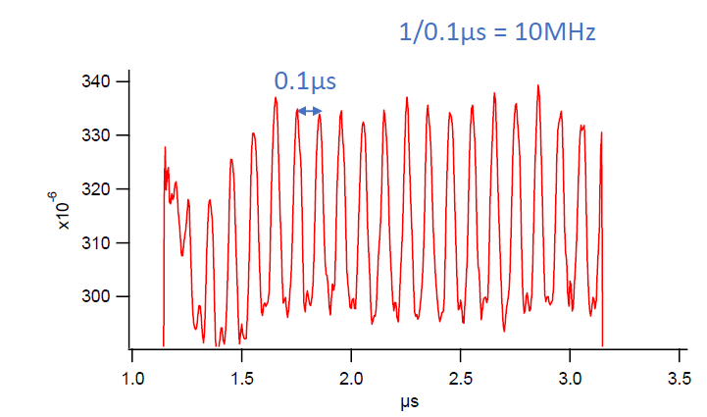
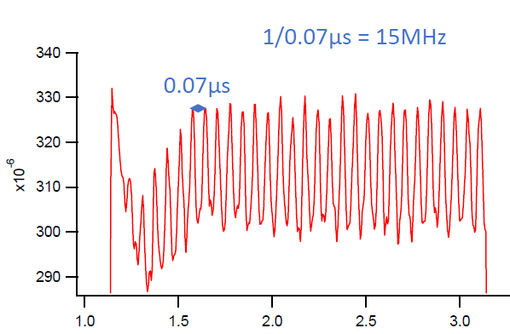
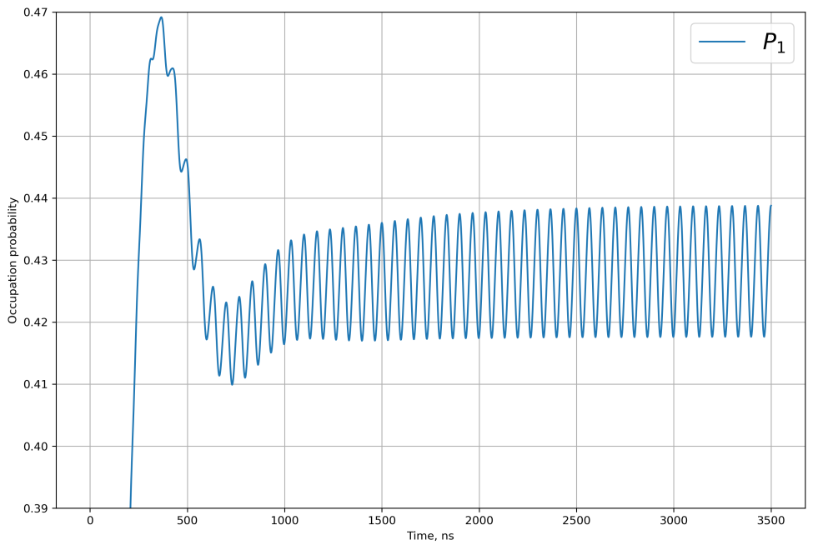
Time-dependent case: transient and stationary regimes
Experiment
Theory
f_{pump} = 5 MHz
P₁
P₁
f_{pump} = 10 MHz
Stationary regime
f_{pump} = 15 MHz
P₁
Transient
regime
7

Slide 8
Conclusions
The stationary case was analyzed.
Interferograms were used to determine:
decoherence time,
power calibration,
multi-photon spectroscopy.
The time-dependent case was also studied.
We deduced that
the qubit dynamics consist of two regimes:
transient and stationary,
the value of reflection coefficient (occupation probability)
oscillates with period
the maxima of the reflection coefficient
are observed at
8

Slide 9
Thank you for your attention!
/
Experiment
Theory
Experiment
Theory
Stationary state – interferometry – characterization
Time-dependent case

Slide 10
Supplemental slides
11

Slide 11
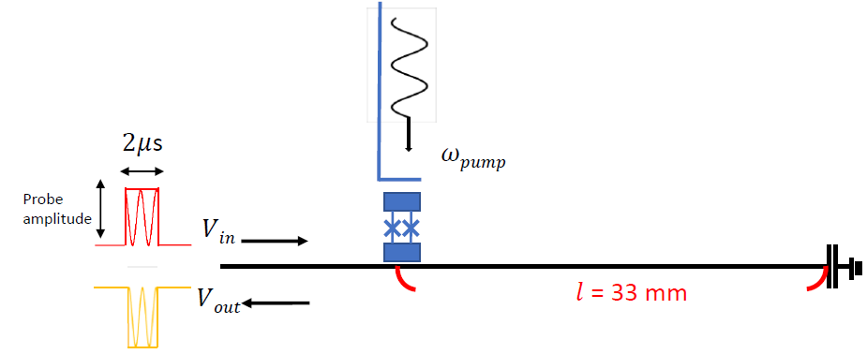
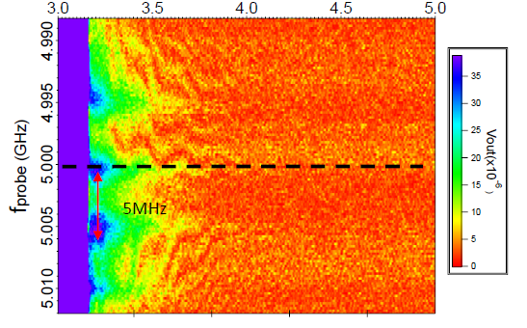
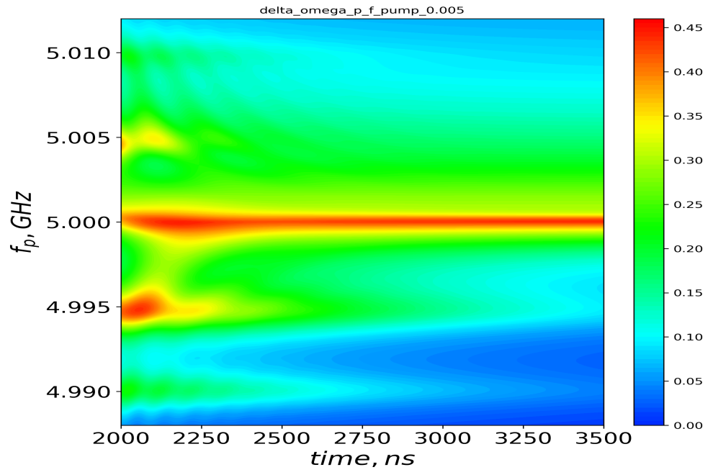
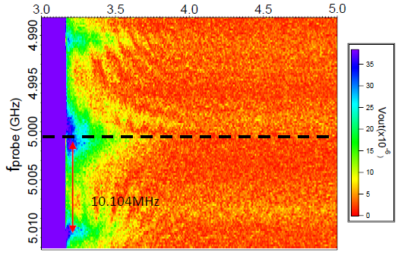
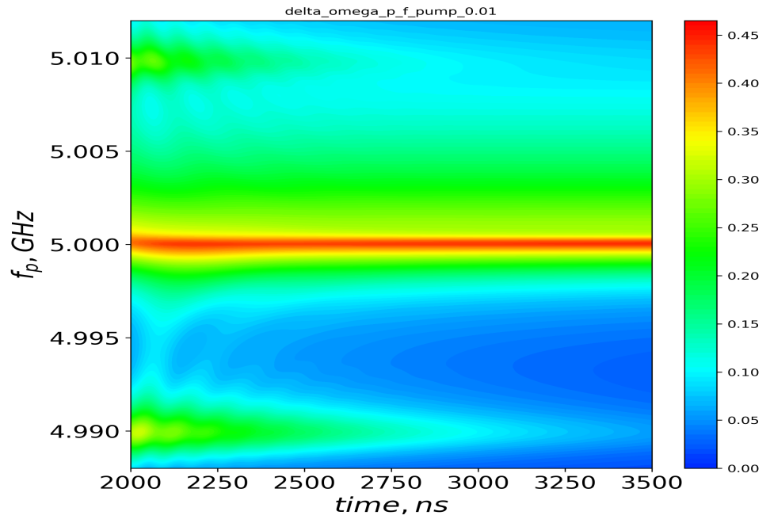
Time-dependent case: Various f_{pump}
Experiment
Theory
f_{pump} = 5 MHz
f_{pump} = 10 MHz
6

Slide 12
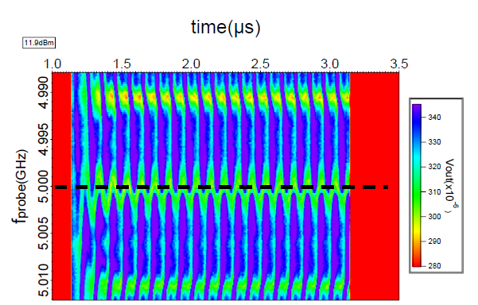
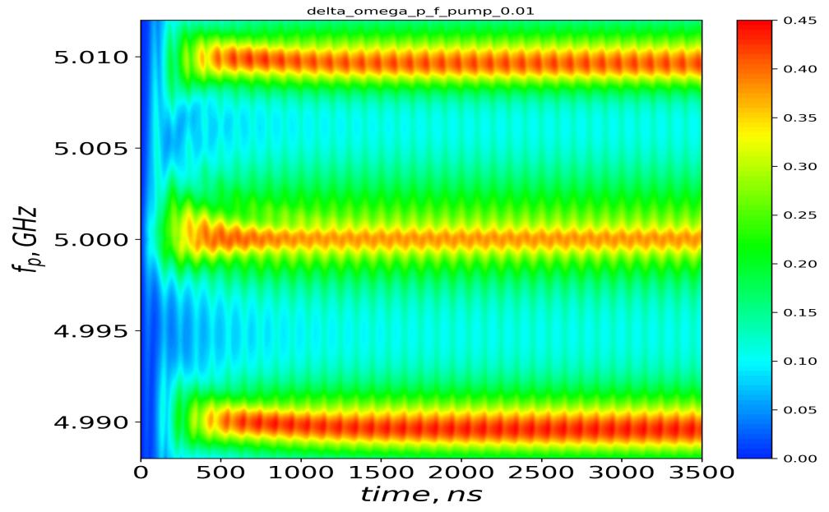
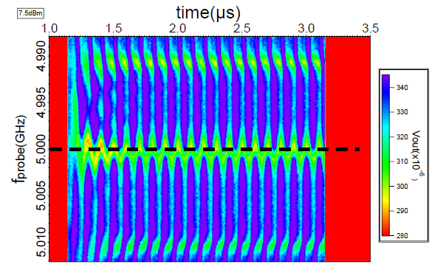

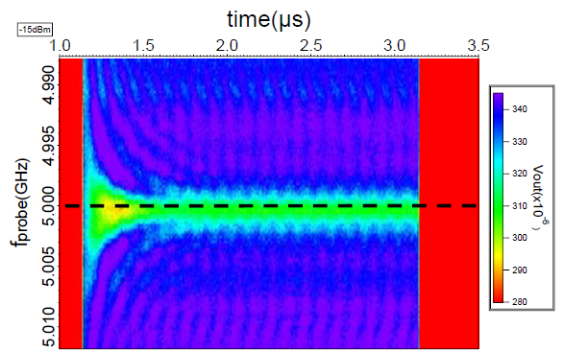
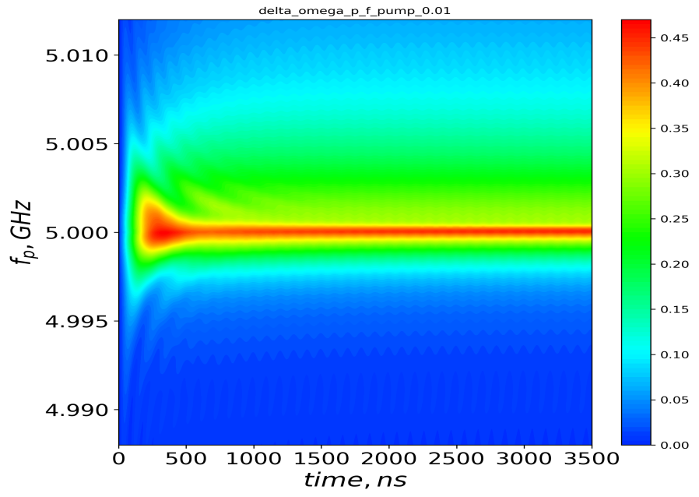

Time-dependent case: Various P_{pump}
Experiment
Theory
P_{pump} = 11.9 dBm
P_{pump} = 7.5 dBm
P_{pump} = -15.0 dBm
8

